Slide 1
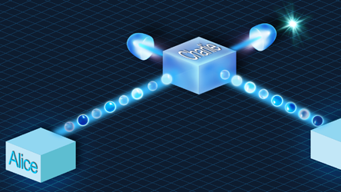
Update meeting 1
Joan, Juan & Timo

Slide 2
Our plans for the project
Implement BB84 on Quantum Inspire Simulator
Implement ‘cleanest’ version
Implement the program on Starmon-5 and Spin-2 (which use the same coding language)
See influence of physical errors
Implement the program on IBM and microsoft backends
Compare even more different types of qubits
Explore Eve posibilities
Explore classical protocols like privacy amplification
Compare the two systems in performance
Implement E91 protocol on the simulator and QuantumInspire hardware
Compare performance with the BB84 protocol and try to explain differences.

Slide 3
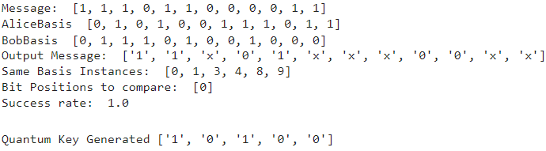
The results so far

Slide 4
Next steps
Performing the whole algorithm in one QI job?
1 qubit vs. multiple qubits?
What types of errors should we use to simulate real-life errors?
What are typical transmission errors?
What are typical rotation errors for gates?
Should we simulate relaxation errors?
Bibliography?
Eve implementation

